Slide 1
What Streaming Service is Best for Me?
IST 652 Final Presentation
Bryan D’Amico, Sintia Stabel, Matthew Smith

Slide 2
Agenda
Introduction
Data Processing
Exploratory Data Analysis
Questions of Interest
General Conclusions
Example User Profile

Slide 3
Introduction
Project Inspiration
More streaming options than ever
Many costs are rising
About the Data
Six Data Sets from Kaggle
Amazon Prime, Disney+, HBOMax, Hulu, Netflix, Paramount+
Sourced from JustWatch Database
Provided by Victor Soeiro
Titles available in U.S. as of Summer 2022

Slide 4
Data Processing
Adding a service column to each data set to identify the streaming service
Combining all into one data frame
25,773 titles with 16 columns of information
Cleaned missing values
Missing age certifications changed to “Not Rated”
Missing title removed
Splitting Genres list into multiple variables

Slide 5
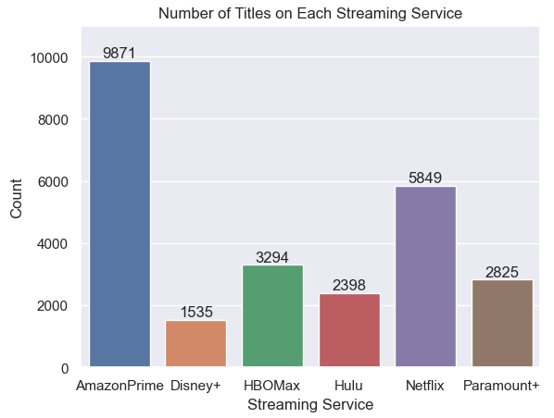
Exploratory Data Analysis
How many titles are available on each streaming service?

Slide 6
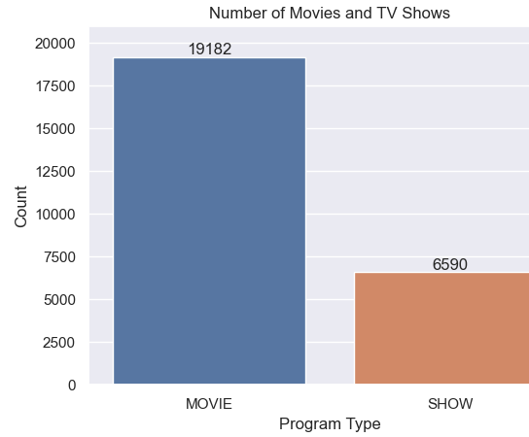
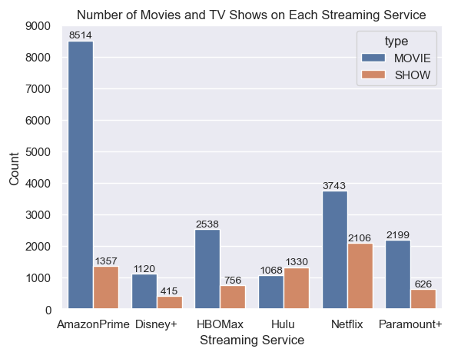
Exploratory Data Analysis
There are many more movies available to stream than there are TV shows

Slide 7
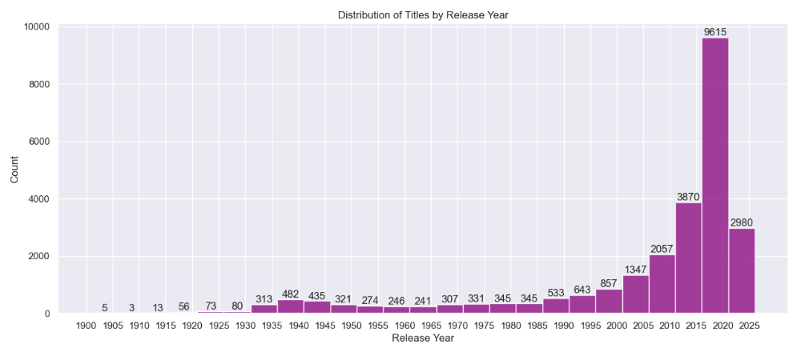
Exploratory Data Analysis
Almost all titles available to stream were released in the 21st century

Slide 8
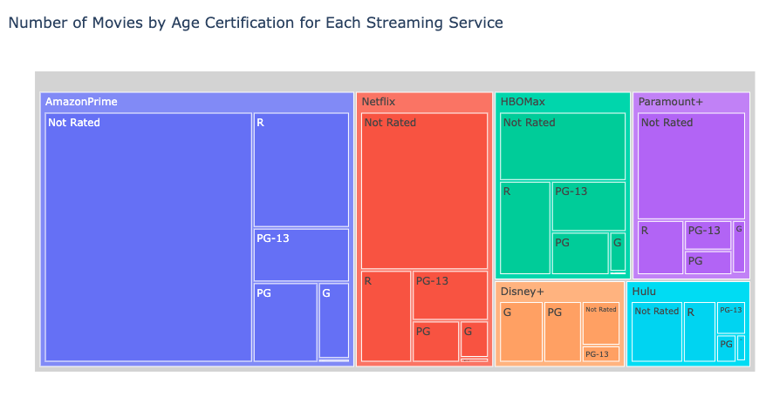
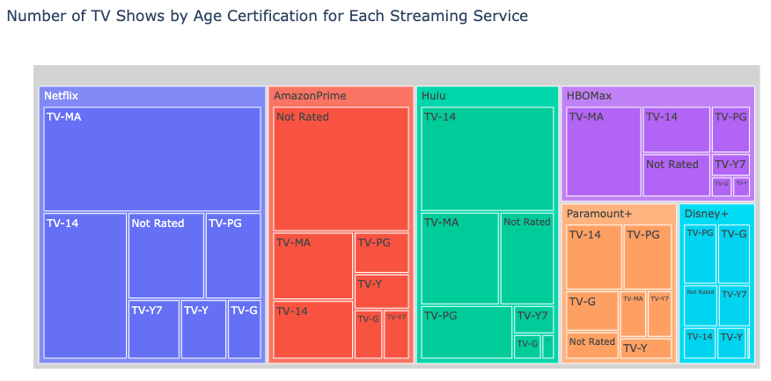
Exploratory Data Analysis
Streaming is not always kid-friendly
Many of the streaming services feature mostly unrated or mature rated programs
Disney+ is the only "family friendly" service
HBOMax has the most mature programming rather than "Not Rated"

Slide 9
Questions of Interest
1) What service has the genres of movies and shows that a potential subscriber might be interested in?
2) What service has the highest rated movies and TV shows?
3) Which streaming services are improving or declining over time?
4) Is a program’s score on IMDB related to the number of votes it receives?
5) Can age certification be determined using the TV show or movie descriptions or genres?

Slide 10
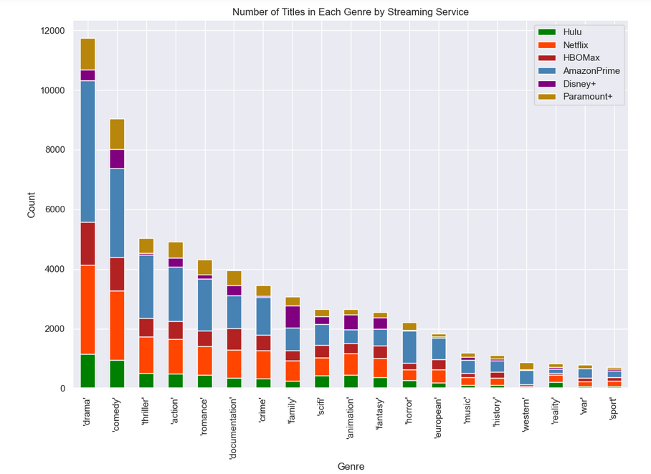
What service has the genres of movies and shows that a potential subscriber might be interested in?
Plot showing the distribution of overall count of genres by service provider

Slide 11
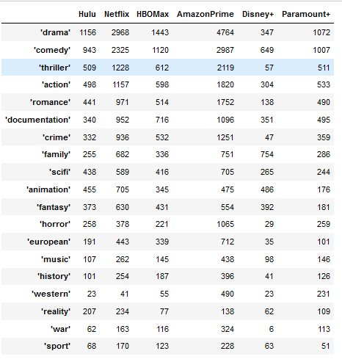
Service Provider Genre Count
Amazon Prime and Netflix have the highest overall counts for drama, comedy and action genres
Amazon Prime and Netflix have the highest count for almost all genres except for reality genre

Slide 12
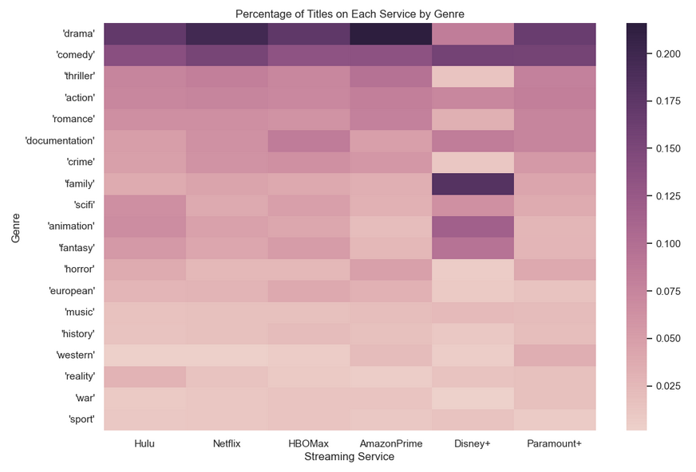
Percentage of Genre Within each Streaming Service Provider
Amazon Prime and Netflix, have the darkest colors for drama and comedy
Disney+ has the highest concentrations for family and animation

Slide 13
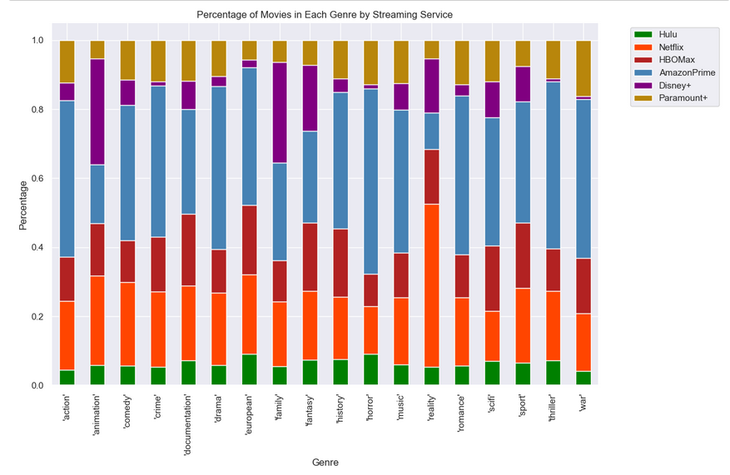
Percentage of Movies by Genres in Each Streaming Service
Amazon Prime and Netflix have the highest proportions
Disney+ has the highest proportion for family and animation movies

Slide 14
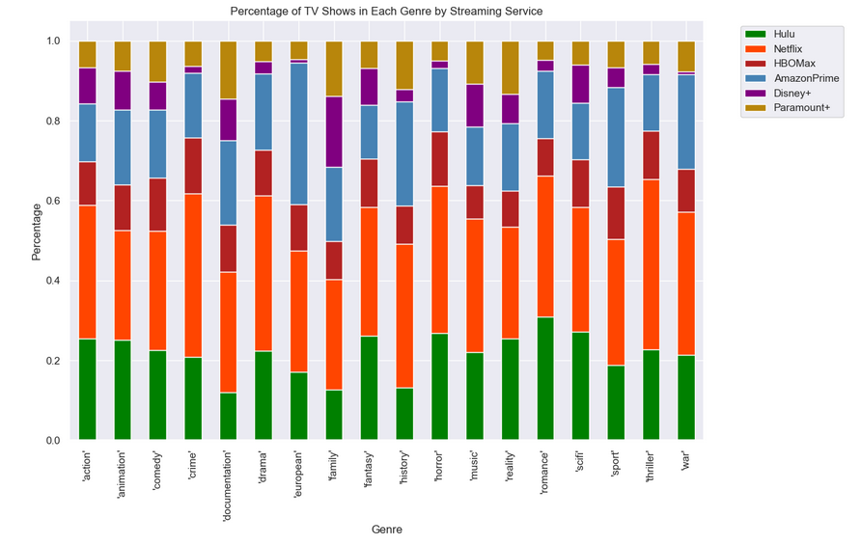
Percentage of TV Shows by Genre in Each Streaming Service
Netflix and Hulu have the highest proportions for romance and fantasy
Hulu and Netflix are also leading in horror and sci-fi shows

Slide 15
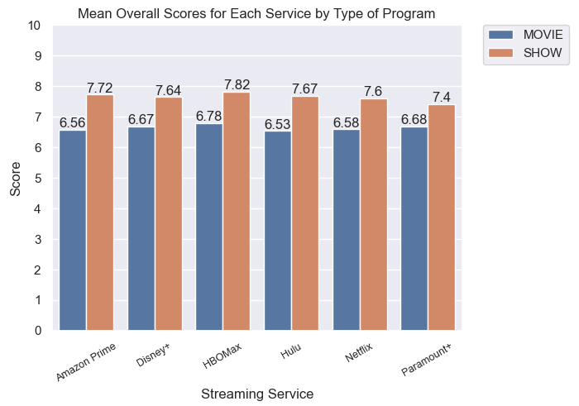
What service has the highest rated movies and TV shows?
Focused on “high profile” titles
In the top 25% of the number of votes received on IMDB
Average of IMDB and TMDB scores

Slide 16
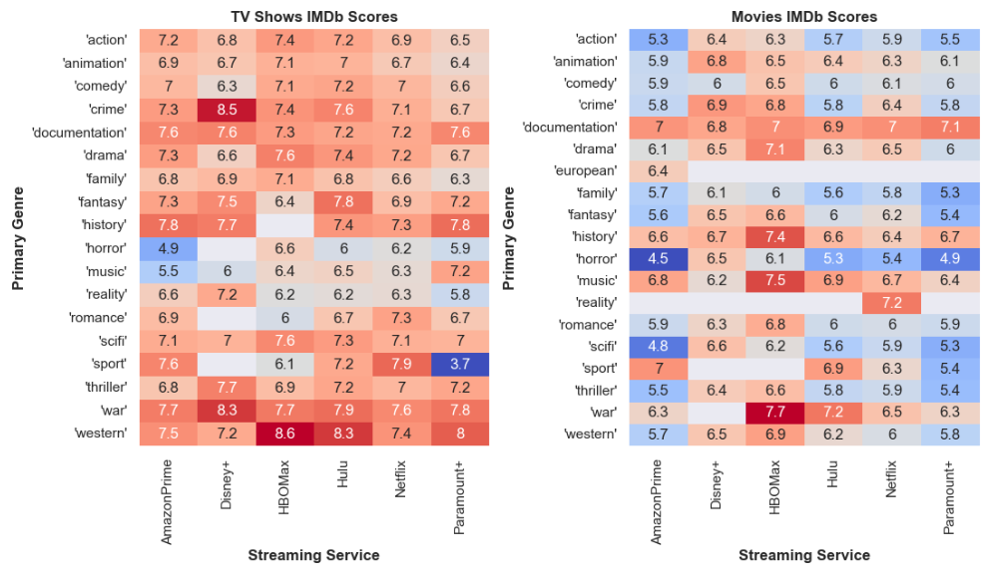
What service has the highest rated movies and TV shows?
Looking at the mean IMDB scores by genre

Slide 17
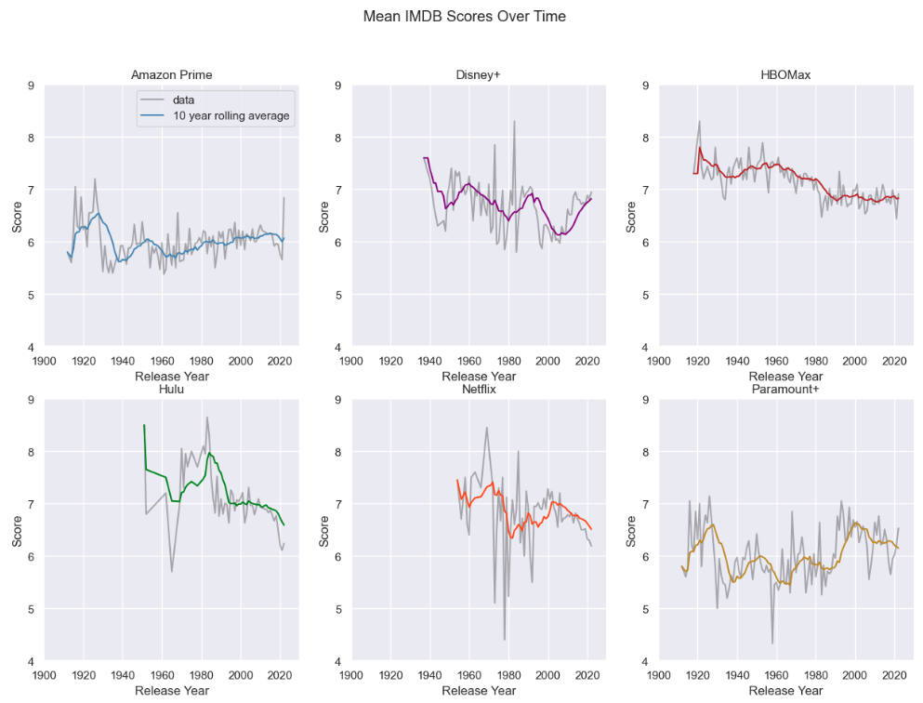
Which streaming services are improving or declining over time?
Average IMDB score grouped by release years
Shows the range of the age of titles available
10 year rolling average smooths out the variation

Slide 18
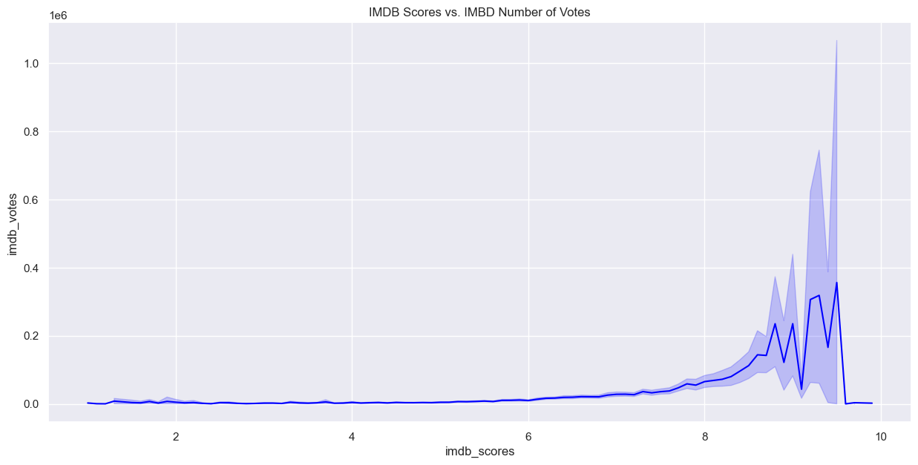
Is a program’s score on IMDB related to the number of votes it receives?
Scores did not appear to have any effect on number of votes until a show/movie hit the 6-10 score range
Possibly due to a response bias, where those with more extreme opinions are more likely to provide feedback
This does not explain why those with lower scores received less votes

Slide 19

Can age certifications be determined using the show or movie descriptions or genres?
In short, yes and no.
Descriptions were not found to have any significant rules associated with age ratings (none with a confidence score of > 0.1)
Genres did have rules with a confidence score of > 0.1.
Not all age rating categories contained significant rules, however.

Slide 20
Conclusions
Almost all streaming content released after 2000
Most content intended for older audiences
Drama and comedy are the genres of most frequently produced programs
HBOMax has the most even split of all genres
HBOMax was the highest scoring service overall
Hulu and Netflix recently released titles are declining in quality
Sharp increase in the number of votes cast for highest rated programs on IMDB
Genres are consistently associated with matching age certifications

Slide 21

Example User Profile
Makayla
Enjoys drama and romance
Two young children: ages 6 and 8
Kids watch TV all afternoon
She wants plenty to watch just for herself after they go to bed
Disney+ best for just kids, but not for everyone
Netflix has greatest proportion of drama and romance, and reality too
Greatest proportion of animated and family shows also
Are at least rated "average"
Over 6,000 titles total!

Slide 22
Thank you!
Any questions?

